Slide 1


KIET Group of Institutions Ghaziabad DEPARTMENT: CSE(AI AND ML)
MINI PROJECT
by
RISHABH BHARTI
VAIBHAV PANJIYAR
PUNEET SINGH
VAISHANV YADAV

Slide 2
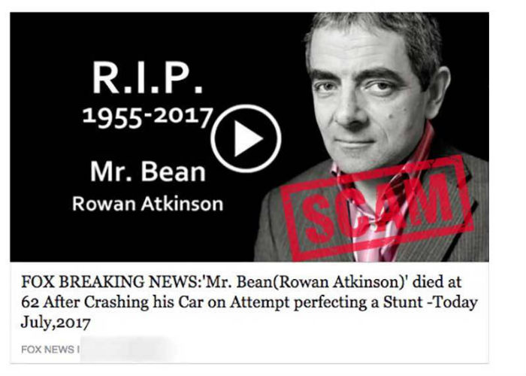
FAKE NEWS DETECTION
What is fake news?
Fake news is false or misleading information presented as news. Fake news often has the aim of damaging the reputation of a person or entity, or making money through advertising revenue.

Slide 3
Why detection of fake news is important?
Researchers in (Kudarvalli & Fiaidhi, 2020) said that detection of false news is necessary because many persons spread the fake news on social media to mislead the people. To Ensure the safety of the individuals or organizations from losing their reputation because of false news it is necessary to detect it (Rahman et al., 2020).

Slide 4
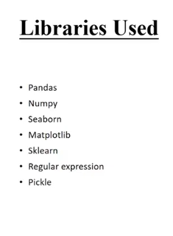
LIBRARIES
We will be using python libraries to predict and find the structure of the spreading of the fake news.

Slide 5
Benchmark Algorithms
Stochastic Gradient Descent
(Stochastic gradient descent is an optimization algorithm often used in machine learning applications to find the model parameters that correspond to the best fit between predicted and actual outputs.)
Random Forest Classification
(The random forest is a classification algorithm consisting of many decisions trees. It uses bagging and feature randomness when building each individual tree to try to create an uncorrelated forest of trees whose prediction by committee is more accurate than that of any individual tree.)
Support Vector Machine
(A support vector machine (SVM) is a supervised machine learning model that uses classification algorithms for two-group classification problems.)
Technology
Which we will be using

Slide 6
WORKING OF FAKE NEWS DETECTION In our work, we use the decoder to make predictions based on the previous sequences of text (news articles) and the previous sequences of user behaviour (how users respond to those articles). Modelling user behaviour in such a temporal manner helps us detect fake news in the early stage.

Slide 7
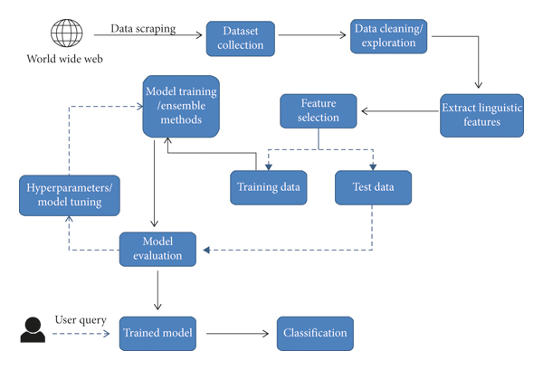

Slide 8
CONCLUSION Fake news detection has many open issues that require attention of researchers. For instance, in order to reduce the spread of fake news, identifying key elements involved in the spread of news is an important step. Graph theory and machine learning techniques can be employed to identify the key sources involved in spread of fake news. Likewise, real time fake news identification in videos can be another possible future direction.

Slide 9
THANK YOU

